Slide 1
E-Asset Management (Group-22)

Slide 2
Team Member
Dipta Ranjan Panda
Harshikha Pal
Manjairi Bangar
Megha Bahuguna
Muskan Banthia
Muskan Jain
Rohan Amrutkar
Rutik Bhandwalkar
Sapan Kumar Srivastava

Slide 3
Project Overview
E-Asset Management is a web based application is used to maintain and control assets that can be borrowed. It keep track of asset in terms of their availability, their current location, the current borrower and the asset history.
The asset borrowed will be returned within specific period of time.If the asset is not returned on time then a fine is imposed on the borrower and system does not lend any asset to borrower for a specific number of days.
The user able to see their information, a list of borrowed items , their details and due dates.
The admin is able to add asset, view over-due assets and able to send message to borrower

Slide 4
Technology Stack
Platform : Spring Tool Suite
Database : MySQL
Frontend : HTML, CSS, JAVASCRIPT
Backend : JAVA, SERVLET

Slide 5
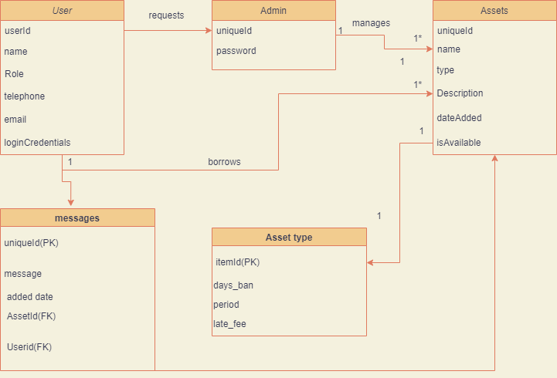
Class Diagram

Slide 6
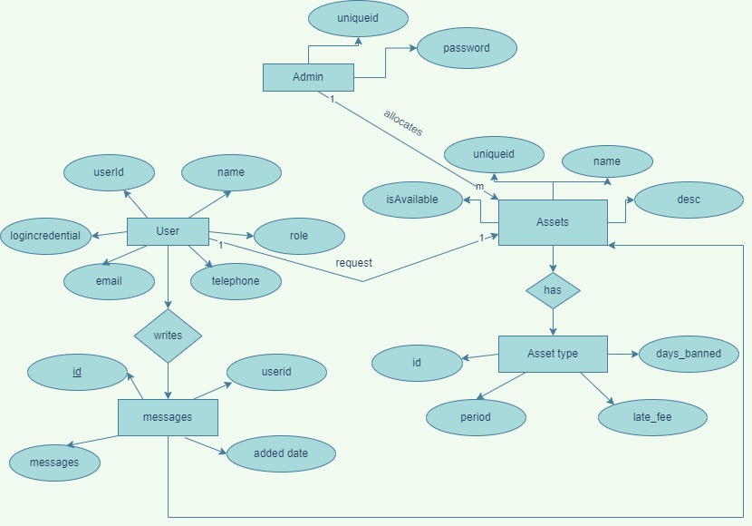
ER Diagram

Slide 7
How To Use Application
User Registration
User Request for Asset
Admin allocate asset based on user record
1
3
5
2
4
6
User Login
Admin Check User History
Asset allocated to user

Slide 8
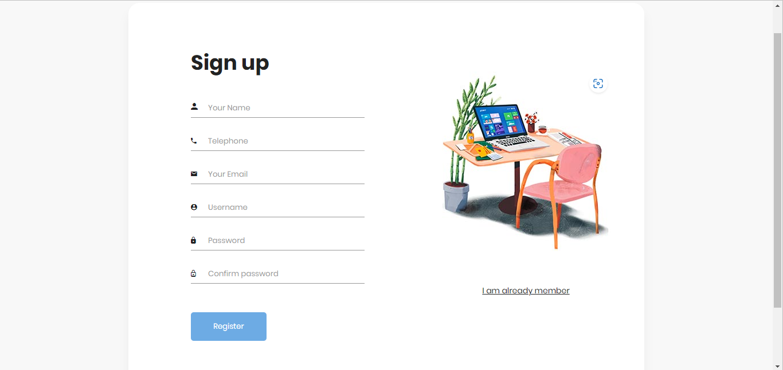
Registration Page

Slide 9
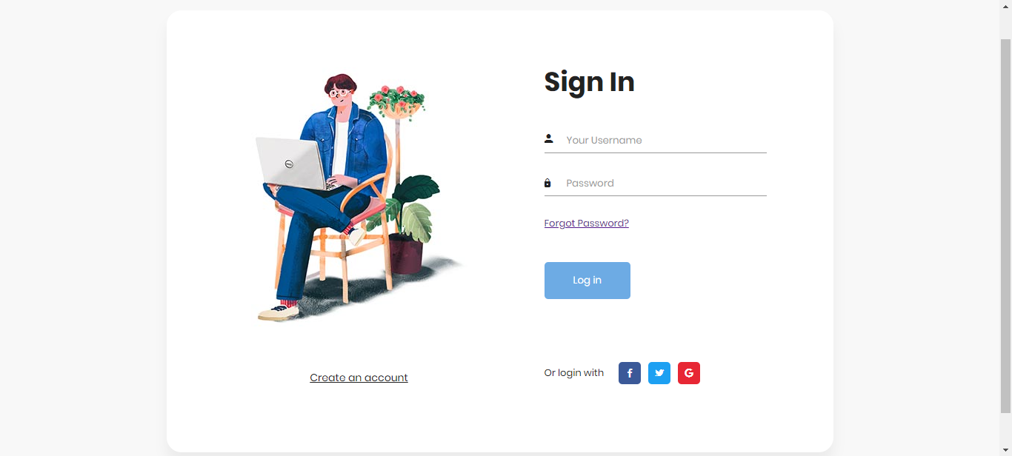
User Login

Slide 10
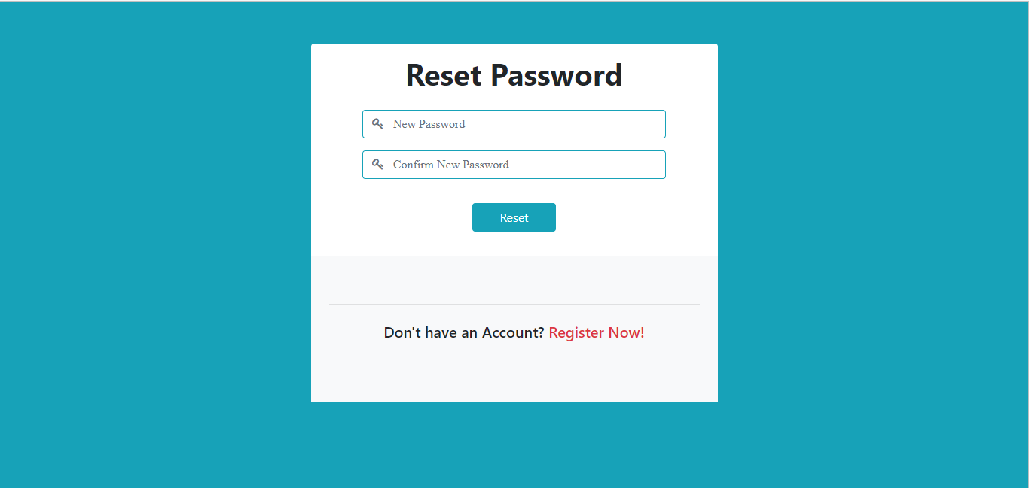
Reset Password Page

Slide 11
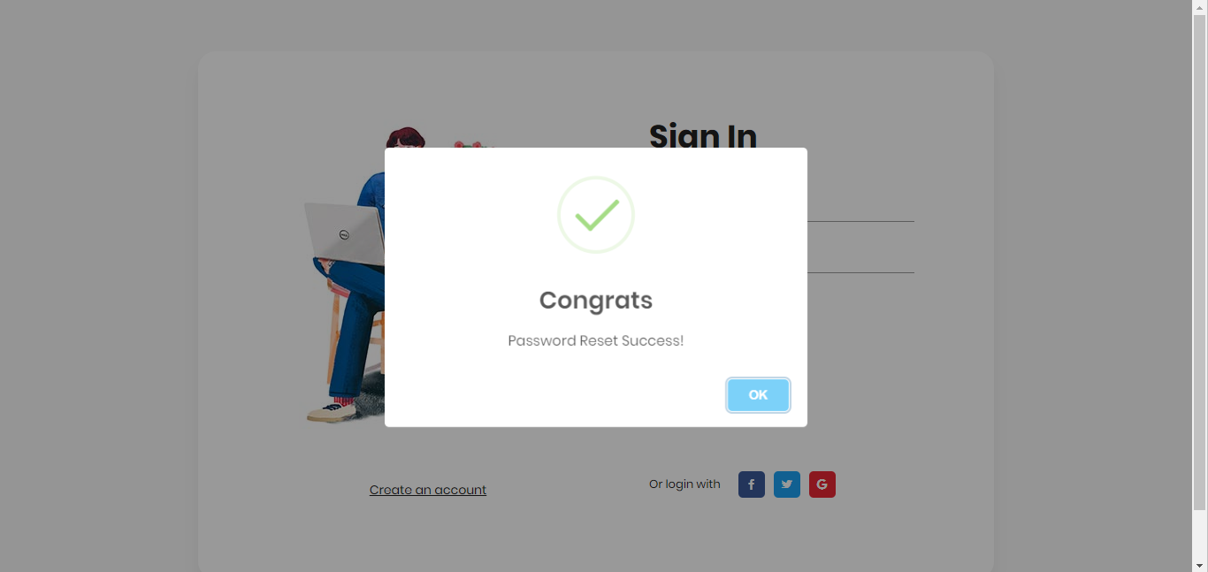
Password Reset Successfully

Slide 12
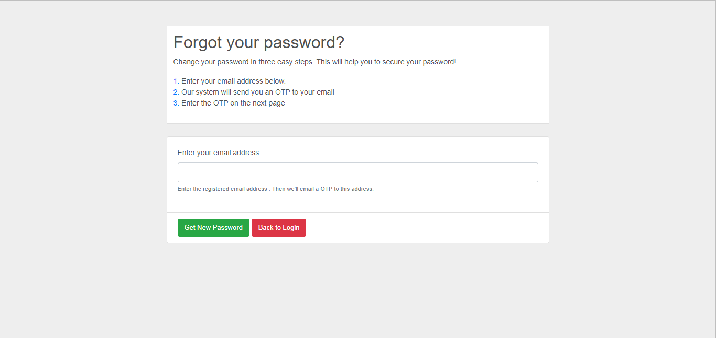
Forgot Password Page

Slide 13
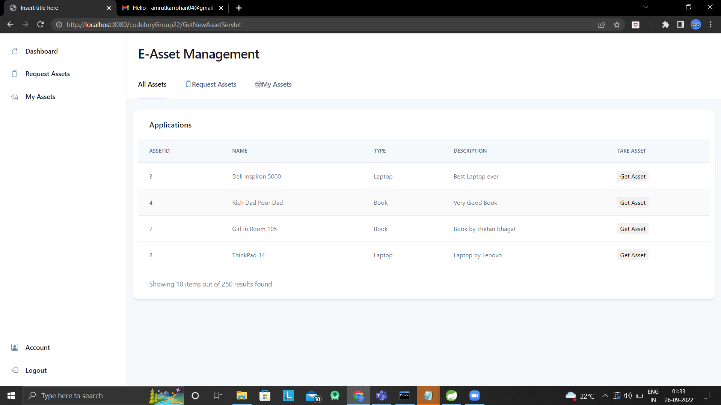
Home Page(User)

Slide 14
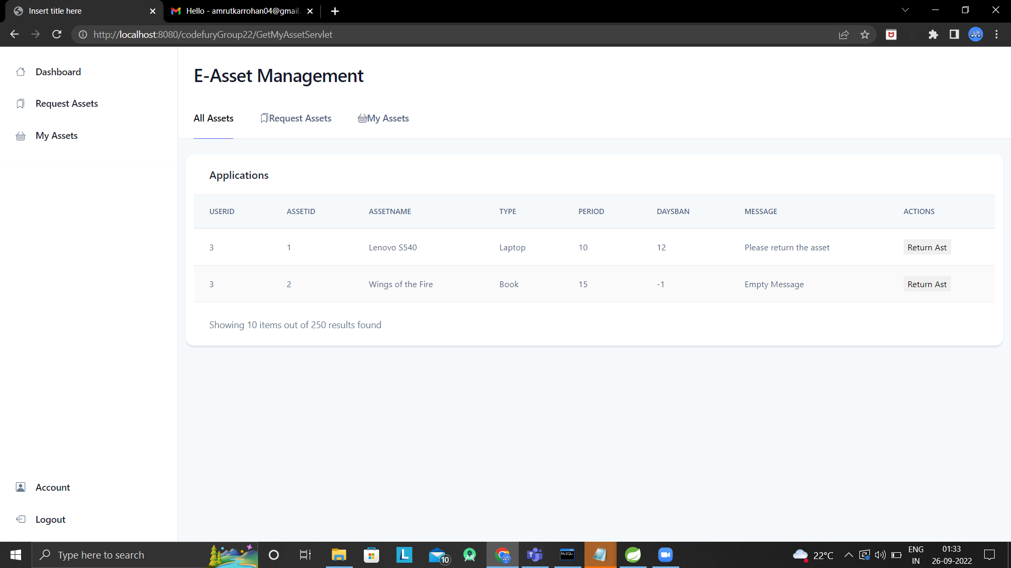

Slide 15
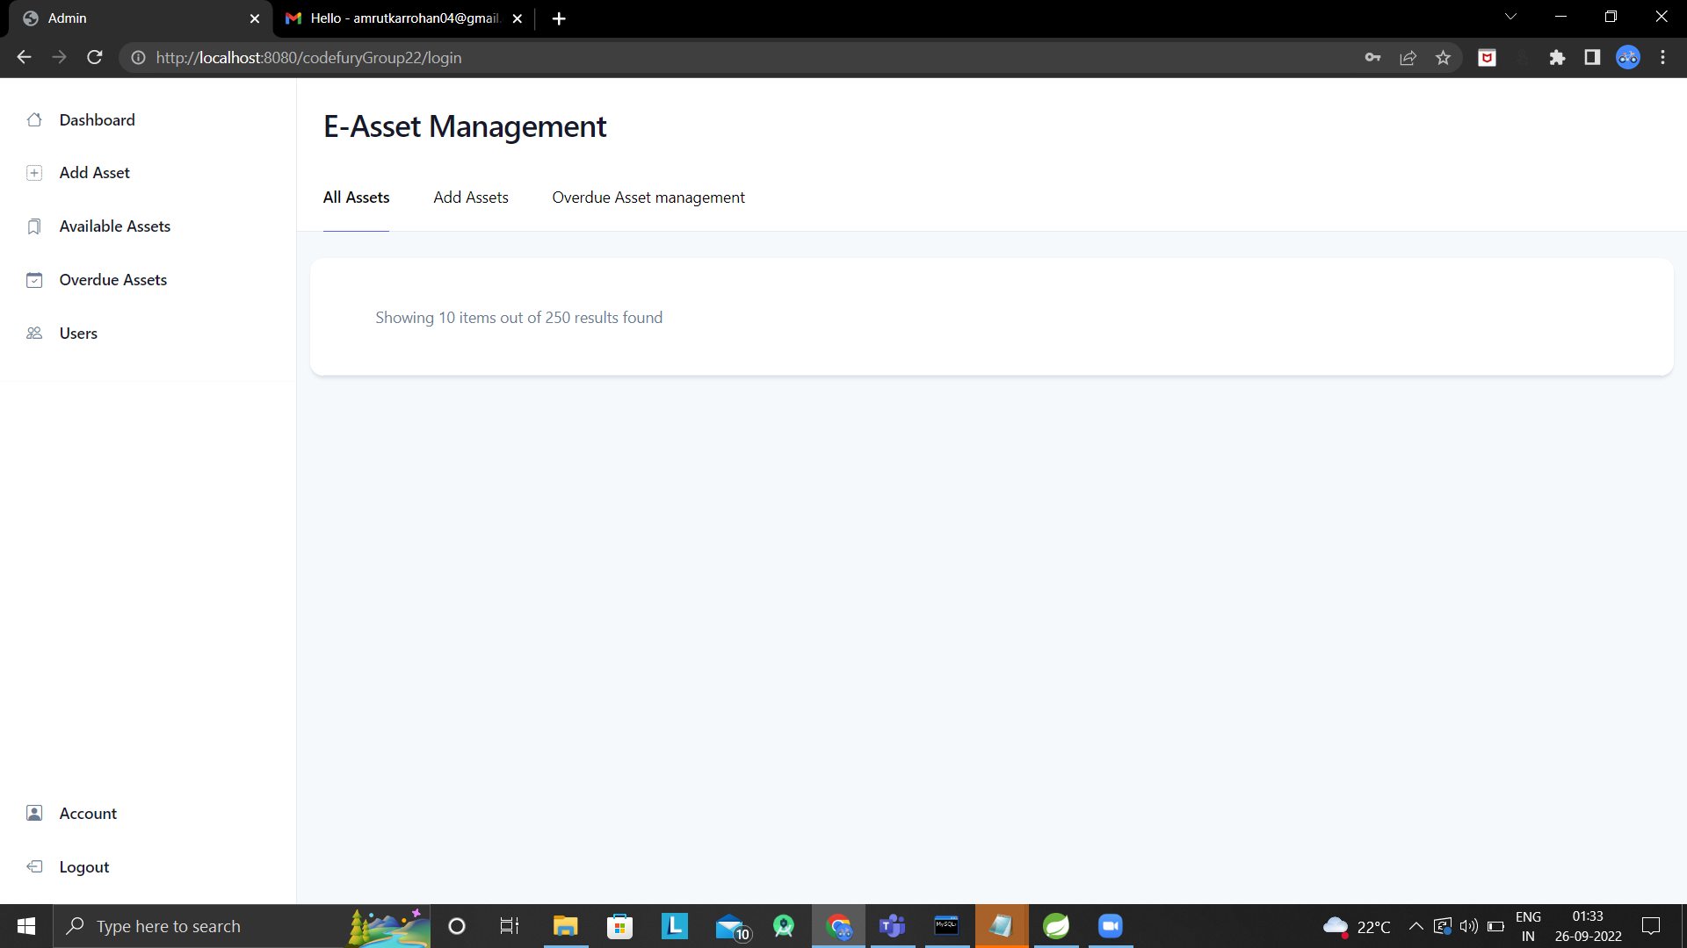
Home Page(Admin)

Slide 16
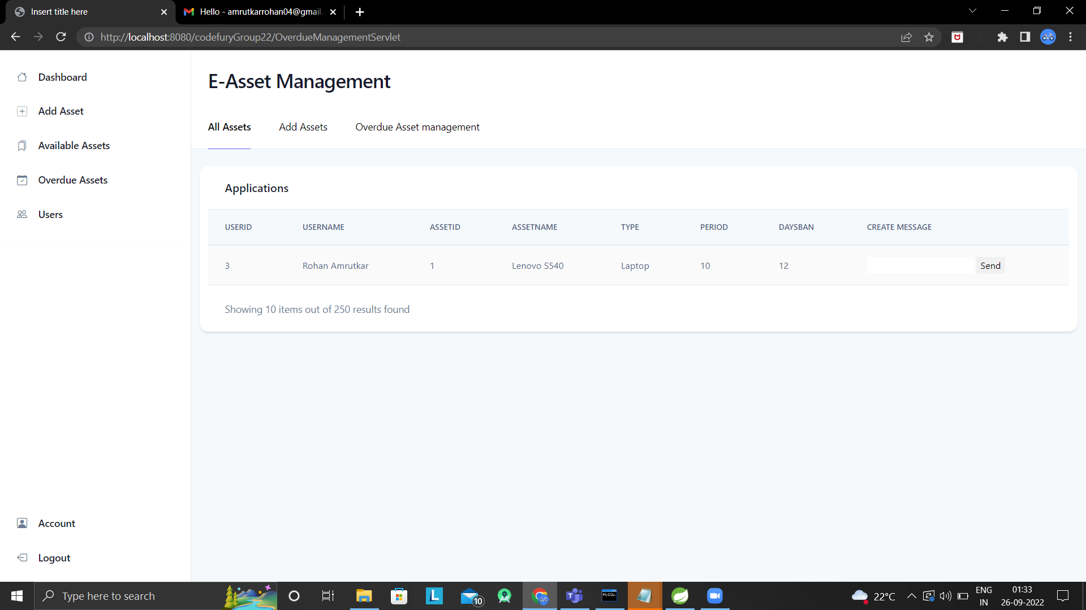

Slide 17
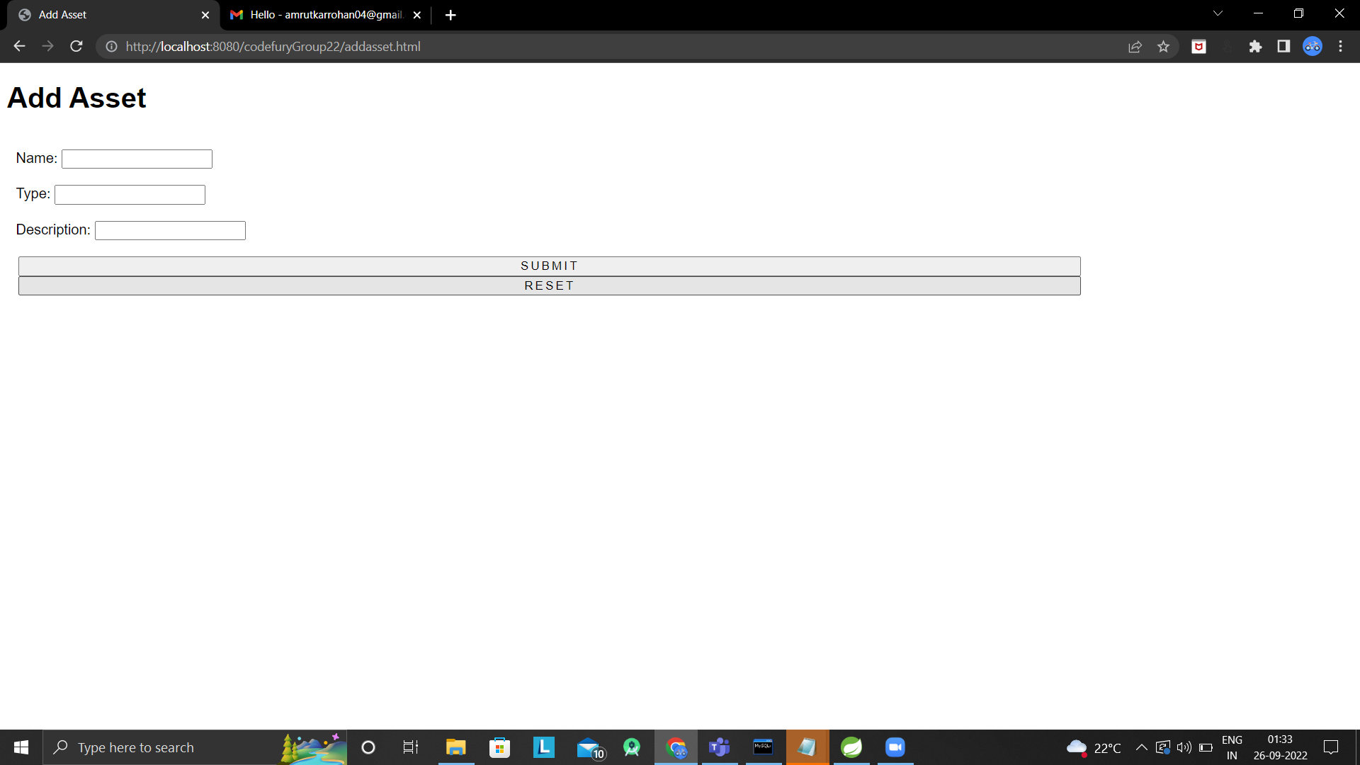
Add asset

Slide 18
Thank You

